Slide 1
Data Acquisition, Ethics, and Responsible Data Science
  How Do Data Scientists Collect Data Responsibly?
  Progressing from how we get data, to the responsibilities we hold once we have it, and finally to the hidden flaws we must check for before analyzing it.
  Why Data Collection Matters?
  Can machine learning produce good predictions from poor-quality data?
  Garbage In → Garbage Out
  The quality of a data science project depends heavily on how data is collected.
Step 1 – Problem Understanding
↓
Step 2 – Data Collection
↓
Step 3 – Data Cleaning
↓
Step 4 – EDA
↓
Step 5 – Modeling
↓
Step 6 – Evaluation
↓
Step 7 – Deployment

Slide 2
Data Acquisition Methods
  What is Data Acquisition?
  The process of collecting data from various sources for analysis.
  Common Sources
  Databases
  Websites
  APIs
  Surveys
  Sensors/IoT Devices
  Social Media
  Public Datasets
How does Netflix collect data?
How does Google Maps collect data?
How does Facebook collect data?

Slide 3
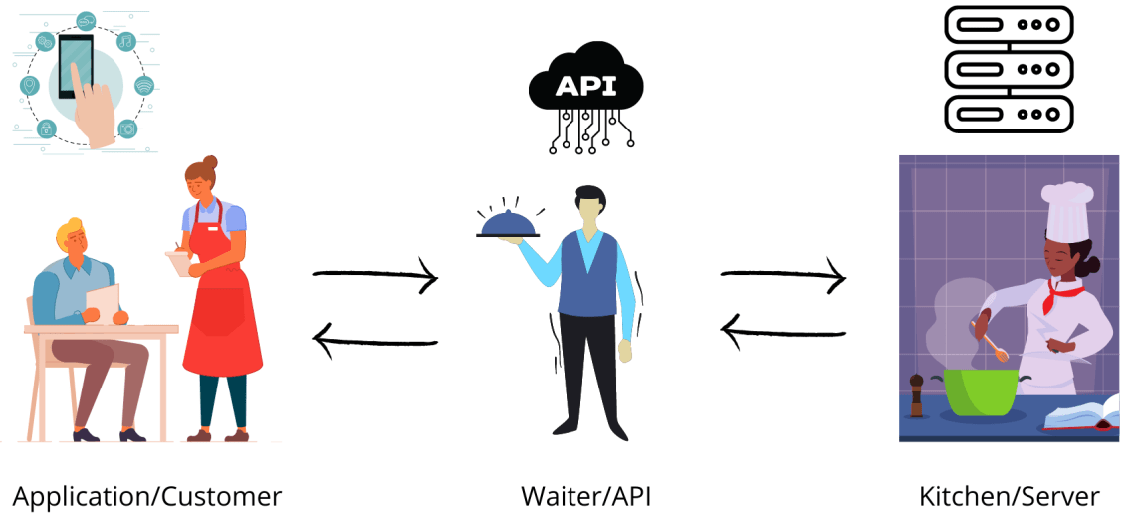
Data Acquisition Methods: API
  Application Programming Interfaces (APIs)
  An API (Application Programming Interface) allows applications to communicate and exchange data.
  Real-World Examples
  Weather API
  Twitter/X API
  Google Maps API
  OpenAI API
  The Classic Pedagogical Analogy: "The Restaurant "
  The Customer (The Client): Sits at the table wanting food (data) but cannot enter the kitchen directly due to safety and organizational rules.
  The Waiter (The API): Takes the customer's specific order (the request parameters), walks it back to the kitchen, and returns later delivering the exact dish (the data response) without the customer ever seeing the internal cooking process.
  The Kitchen (The Server/Database): The backend system that processes the order, contains the raw ingredients, and compiles the final product.

Slide 4
Data Acquisition Methods: Web Scraping
  What is Web Scraping?
  An automated programmatic method to extract unlabeled or semi-structured data directly from the raw HTML structure of webpages when an explicit API is absent.
  Core Workflow
  HTTP requests → Parsing the HTML DOM Tree → Variable extraction
  Is every website okay to scrape?
  Emphasize checking a site's /robots.txt file to check programmatic access rules.
API | Web Scraping
Official access | Extract from webpage
Structured data | HTML parsing
More reliable | More fragile
Preferred when available | Used when API unavailable

Slide 5
Data Acquisition Methods: Surveys and Questionnaires
Good Survey Design
Good Question
How satisfied are you with the course?
Poor Question
Don't you agree that the course is excellent?
Explain:
  Neutral wording
  Avoid leading questions
  Avoid ambiguity
Types of Questions
Open-ended
What improvements would you suggest?
Closed-ended
Rate the course from 1–5.
  Why Surveys?
Sometimes data does not already exist.
Need to ask people directly.
Examples:
Customer satisfaction
Student feedback
Public opinion

Slide 6
Data Governance, Privacy, and Ethics
What is Data Ethics?
The responsible use of data throughout its lifecycle.
Ethical Questions
Was consent obtained?
Is data collection transparent?
Can the data harm individuals?
Is the analysis fair?
Famous Example
Discuss the importance of responsible handling of social media data and user information.

Slide 7
Data Governance, Privacy, and Ethics
What is Bias?
Systematic errors embedded within the collected data that lead to unfair or inaccurate outcomes.
Example 1: Sampling Bias
Survey only university students.
Question: Do the results represent all citizens?
Answer: No
Example 2: Gender Bias
Suppose a hiring dataset contains mostly male applicants.
A model trained on such data may learn biased patterns.
What is Fairness?
Ensuring that decisions do not unfairly disadvantage particular groups.
Discussion Activity
Ask: If an AI system approves loans for one group more often than another, is it necessarily fair?

